Slide 1


Vilinie Singh 25/02/2025

Slide 2

Outline
Executive Summary
Introduction
Methodology
Results
Conclusion
Appendix

Slide 3
Executive Summary
Summary of methodologies
Data was collected from the SpaceX Api and the SpaceX Wikipedia’s page
Data Wrangling was done (categorical features were modified using one-hot encoding)
EDA were carried out using SQL, Data Visualization methods and Folium (maps, dashboards, graphs, charts)
Summary of all results
Machine learning predictions were made by producing the following four: K Nearest Neighbours, Support Vector Machines, Decision Tree Classifier and Logisitic Regression; all of which produced similar results of 83 percent, all of which predicted successful landings.

Slide 4
Introduction
Project background and context
As seen on the Space X website the Falcon 9 rocket launches with a cost of 62 million dollars. However, there exists others with costs of 165 million dollars. The drastic levels in cost is a result of Space X being able to recover and reuse parts of the rocket within Stage 1.
The purpose of this project is to determine whether the Stage 1 will launch successfully; this is determined through the means of a machine learning pipeline.
Problems you want to find answers
What properties will help to determine a successful launch?
What conditions are ultimately necessary to ensure a successful launch?

Slide 5

Section 1

Slide 6
Methodology
Executive Summary
Data collection methodology:
Data was collected through the means of the SpaceX API and web scraping from the Wikipedia website.
Perform data wrangling
Data was processed by applying one-hot encoding to categorical features
Perform exploratory data analysis (EDA) using visualization and SQL
Perform interactive visual analytics using Folium and Plotly Dash
Perform predictive analysis using classification models
Models were tuned using GridSearchCV

Slide 7
Data Collection
Data was collected using the API from the public SpaceX API and the web scraping data from the SpaceX Wikipedia page.
The .json() function call was used to decode the response content information from the API and then was converted to a dataframe by using the Pandas library and the .json_normalize() function call.
Furthermore, the BeautifulSoup library was used to carry out the web scraping on the Wikipedia page. The launch records were collect and converted into a dataframe using the Pandas library for further analysis.

Slide 8
Data Collection – SpaceX API
Request (via the APIs)
The GET request method was used to collect data from the SpaceX API.
Github Link: https://github.com/veeweenee/IBM-DS-Capstone-Course/blob/main/jupyter-labs-spacex-data-collection-api.ipynb
Use .json_normalize to convert from JSON to DataFrame
Condense DataFrame to only relevant data
Filter the data to have only Falcon 9 launches
Calculate the number of missing PayloadMass values with the mean function

Slide 9
Data Collection - Scraping
Request (Wikipedia html content)
Data was scraped from the Wikipedia page by using the BeautifulSoup library.
Findings of the launch information were then casted to a DataFrame for further exploration.
GitHub URL: https://github.com/veeweenee/IBM-DS-Capstone-Course/blob/main/jupyter-labs-webscraping.ipynb
Parse with BeautifulSoup
Locate the launch info from the html content (from the table)
Extract the info from the html table and input into a dictionary
Cast the dictionary to/display in a DataFrame

Slide 10
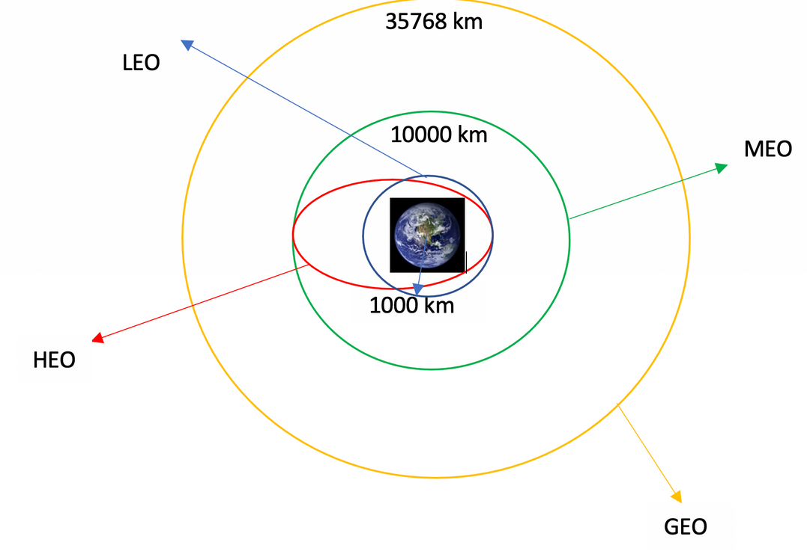
Data Wrangling
An exploratory data analysis was done to determine the training labels where the landing outcomes were successful (1) or a failure (0)
Launches at each site, sightings at all orbits were calculated.
Github URL: https://github.com/veeweenee/IBM-DS-Capstone-Course/blob/main/labs-jupyter-spacex-Data%20wrangling.ipynb

Slide 11
EDA with Data Visualization
Several plots were used to compare the different relationships between the variables. The purpose of this is to test to see viable relationships could be used to train the machine. This type of analysis were performed using the following variables:
FlightNumber
PayloadMass
LaunchSite
Class
Orbit
Year
Github URL: https://github.com/veeweenee/IBM-DS-Capstone-Course/blob/main/edadataviz.ipynb

Slide 12
EDA with SQL
An exploratory data analysis was carried out but by using SQL.
Mainly, queries were made to fully understand the data within the dataset. Queries were done based on landing outcomes, booster versions, payload sizes, etc.
Github URL: https://github.com/veeweenee/IBM-DS-Capstone-Course/blob/main/jupyter-labs-eda-sql-coursera_sqllite(1).ipynb

Slide 13
Build an Interactive Map with Folium
An interactive map was made using the Folium library to mark landings (successful and failed ones), launch sites and specific locations (such as railways, cities).
This was done to fully grasp why launch sites have been based within a specific location.
Github URL: https://github.com/veeweenee/IBM-DS-Capstone-Course/blob/main/lab_jupyter_launch_site_location.ipynb

Slide 14
Build a Dashboard with Plotly Dash
Added to the dashboard are plots such as a scatterplot and pie chart.
The scatterplot was added to display the variation when it comes to success rates in relation to booster versions, payload masses, etc.
The pie chart was added as a display of the various success rates of launch sites.
GitHub URL:https://github.com/veeweenee/IBM-DS-Capstone-Course/blob/main/DV0101EN-Final-Assign-Part-2-Questionss.py

Slide 15
Predictive Analysis (Classification)
Data was split into two sets (training and testing)
Various machine models were built using GridSearchCV (Logistic Regression, Support Vector Machine, Decision Tree Classifier and K Nearest Neighbours)
Accuracy was used as a metric for the models and the best performing model was found.
Github URL: https://github.com/veeweenee/IBM-DS-Capstone-Course/blob/main/SpaceX_Machine%20Learning%20Prediction_Part_5.ipynb

Slide 16
Results
Exploratory data analysis results
Interactive analytics demo in screenshots
Predictive analysis results

Slide 17

Section 2

Slide 18
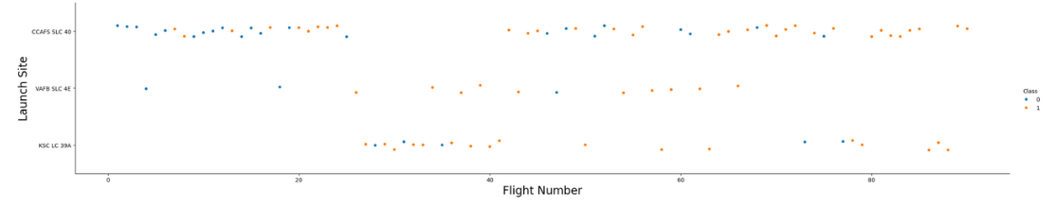
Flight Number vs. Launch Site
It can be seen from the plot above that the number of flights present at a launch site, the higher is the success rate.

Slide 19
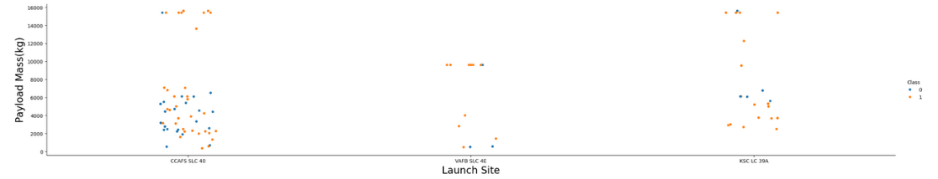
Payload vs. Launch Site
It can be seen from the plot above that the payload mass is at the CCAFS SLC 40 launch site, the higher is the success rate for the Falcon 9 rocket

Slide 20
Success Rate vs. Orbit Type
From the bar plot it can be seen the four of the Orbits have higher success rate than the others.

Slide 21
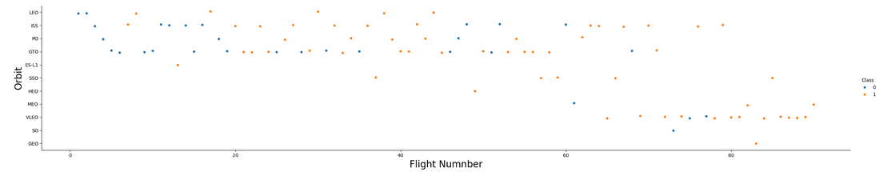
Flight Number vs. Orbit Type
It can be seen from the plot there are two notable findings:
There is a relationship between the success of the number of flights when analyzing the LEO orbit.
There exists no relationship between the number of flights when analyzing the GTO orbit.

Slide 22
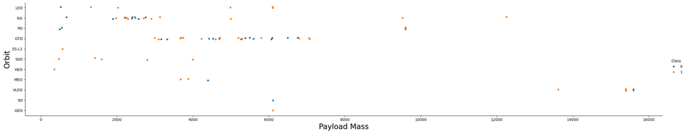
Payload vs. Orbit Type
As seen in the scatterplot above, successful landings occur more for PO, ISS and LEO orbits when considering heavy payloads.

Slide 23
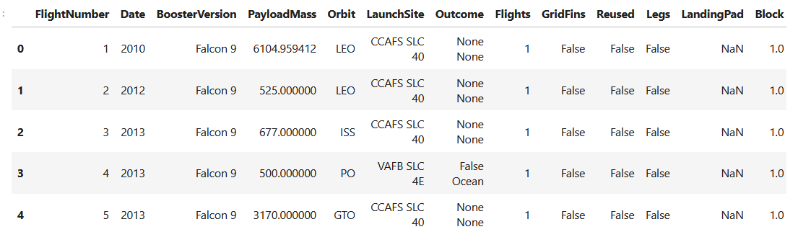
Launch Success Yearly Trend
Using the information above a line chart was plotted which displayed that the success rate kept a steady increase from 2013 until 2010

Slide 24
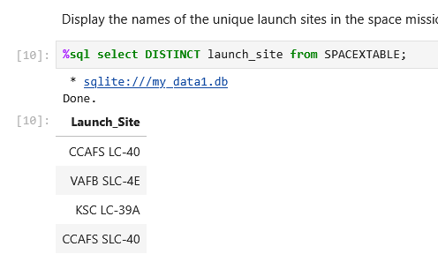
All Launch Site Names
Using the DISTINCT keyword, four unique launch sites were found, namely:
KSC LC-39A
CCAFLS LC-40
VAF8 SLC-4E
CCAFLS SLC-40

Slide 25
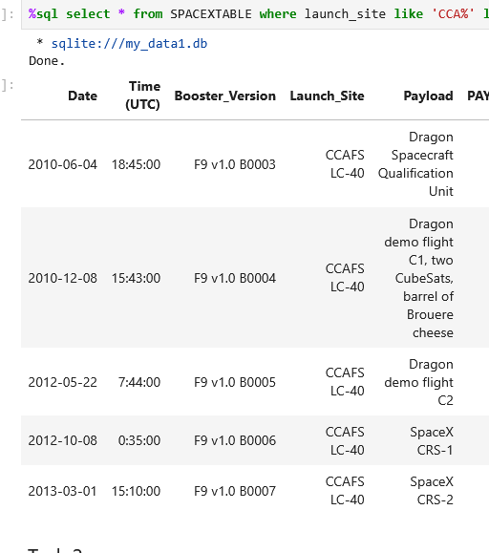
Launch Site Names Begin with 'CCA'
The following query was used to find the names beginning with CCA:
%sql select * from SPACEXTABLE where launch_site like 'CCA%' limit 5

Slide 26
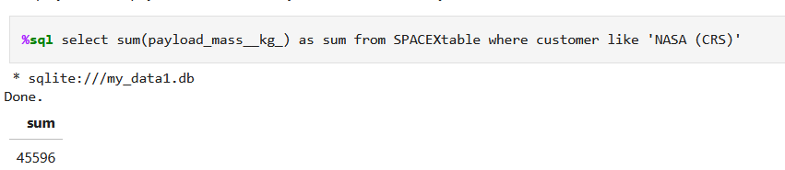
Total Payload Mass
Using the following query the total payload mass was calculated:

Slide 27
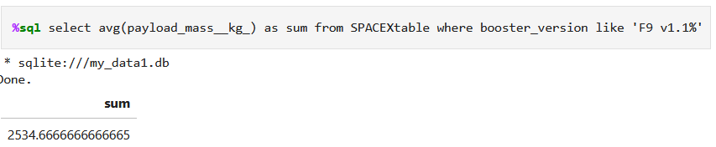
Average Payload Mass by F9 v1.1
Using the following query, the average payload mass by F9 c1.1 was calculated to 2534.66

Slide 28
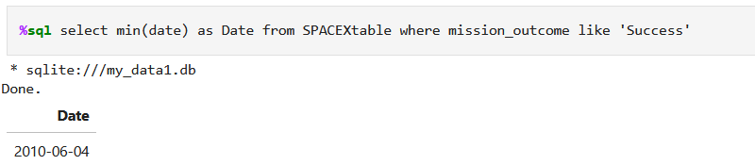
First Successful Ground Landing Date
Using the following query, the first successful ground landing date was calculated to 2010-06-04

Slide 29
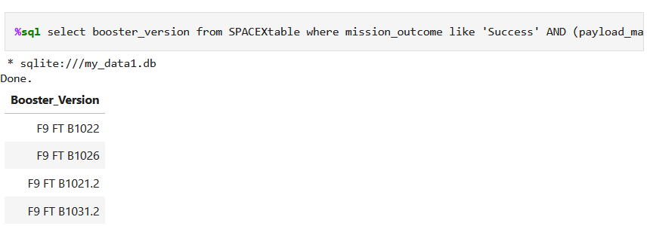
Successful Drone Ship Landing with Payload between 4000 and 6000
Using the query below, the names of boosters which have successfully landed on drone ship and had payload mass greater than 4000 but less than 6000 are as follows:

Slide 30
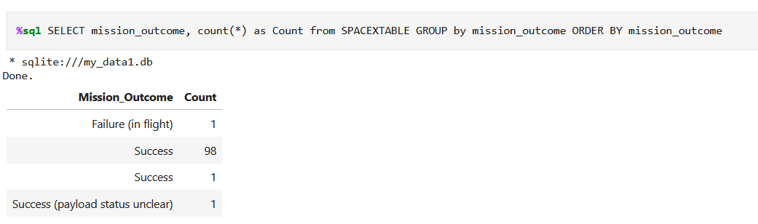
Total Number of Successful and Failure Mission Outcomes
The calculation of the total number of successful and failure mission outcomes were done. It is seen that there was a failure (in flight), 99 successes and a single success where the payload status was unclear.

Slide 31
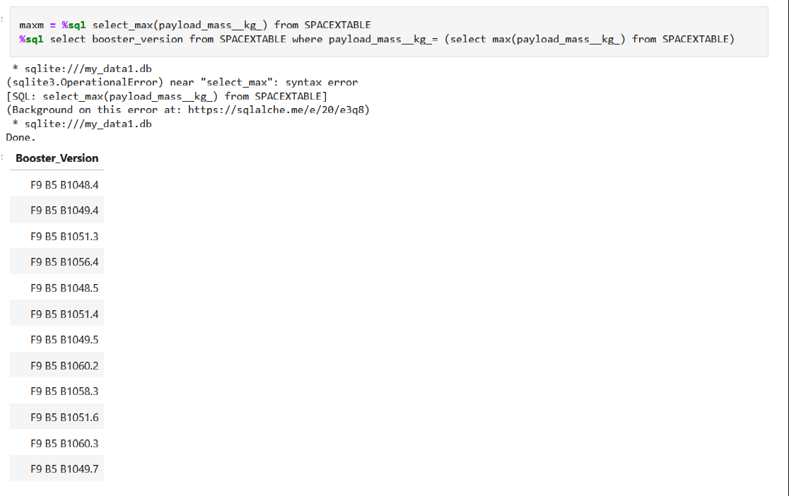
Boosters Carried Maximum Payload
The names of the booster which have carried the maximum payload mass were calculated by using the query (seen below) and produced the following results:

Slide 32
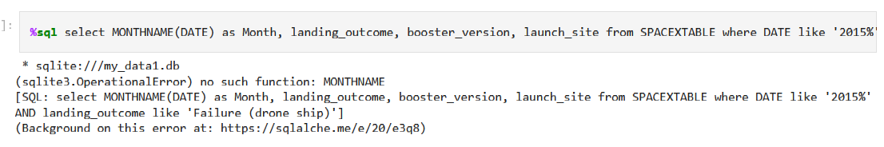
2015 Launch Records
The failed landing_outcomes in drone ship, their booster versions, and launch site names for in year 2015 are listed below:

Slide 33
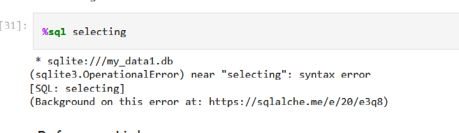
Rank Landing Outcomes Between 2010-06-04 and 2017-03-20
The count of landing outcomes (such as Failure (drone ship) or Success (ground pad)) between the date 2010-06-04 and 2017-03-20, in descending order are ranked below:

Slide 34

Section 3

Slide 35
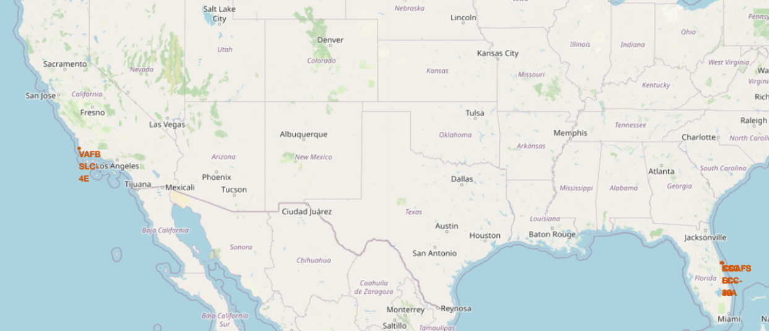

Launch Site locations
It can be seen that the launch site is in Florida and near the coast.
Here we can see both launch sites are located in Florida and in California, by the coasts.

Slide 36
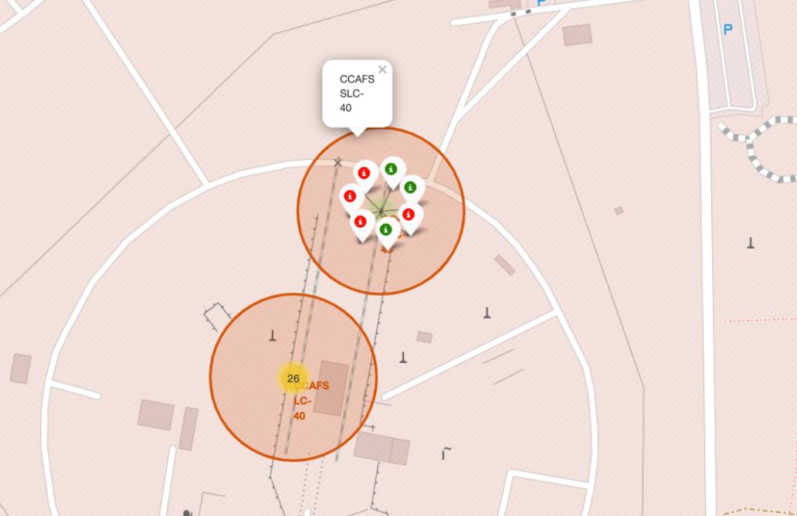
Color-coded markers showing launch sites
Red markers show failed outcomes of launching; green show successful outcomes of the CCAFS SLC-40

Slide 37
Key Location Proximities to Launch Sites
According to the map, it is seen that launch sites are stationed towards the coastlines, away from the city, more towards railways for the main purpose of transportation for workers and materials needed.
It is to be noted that launch sites are located away from the cities and more towards the sea area for the reason that if there are any failures in launch, rocket debris will not cause harm upon anyone/ anything within those areas and will fall in the sea or water areas.

Slide 38

Section 4

Slide 39
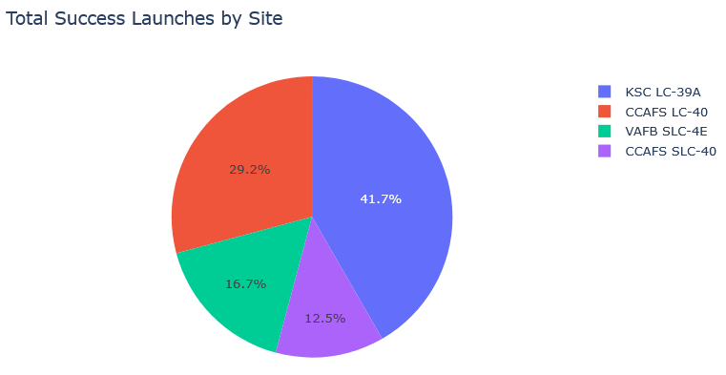
Success rate of each launch site by percentage
Amongst the four launch sites, it is seen that the most popular one is the KSC LC-39A site.

Slide 40
Launch Site with the highest success rate
As indicated by the pie chart, the KSC LC-39A has the highest success rate. With more than seventy percent of successful landings and under thirty percent of failed ones.

Slide 41
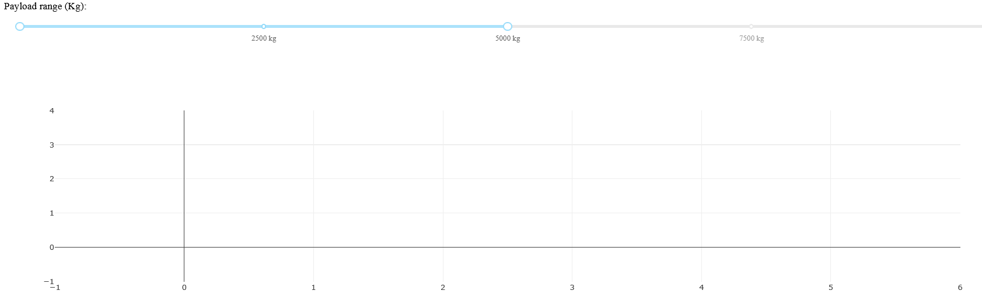
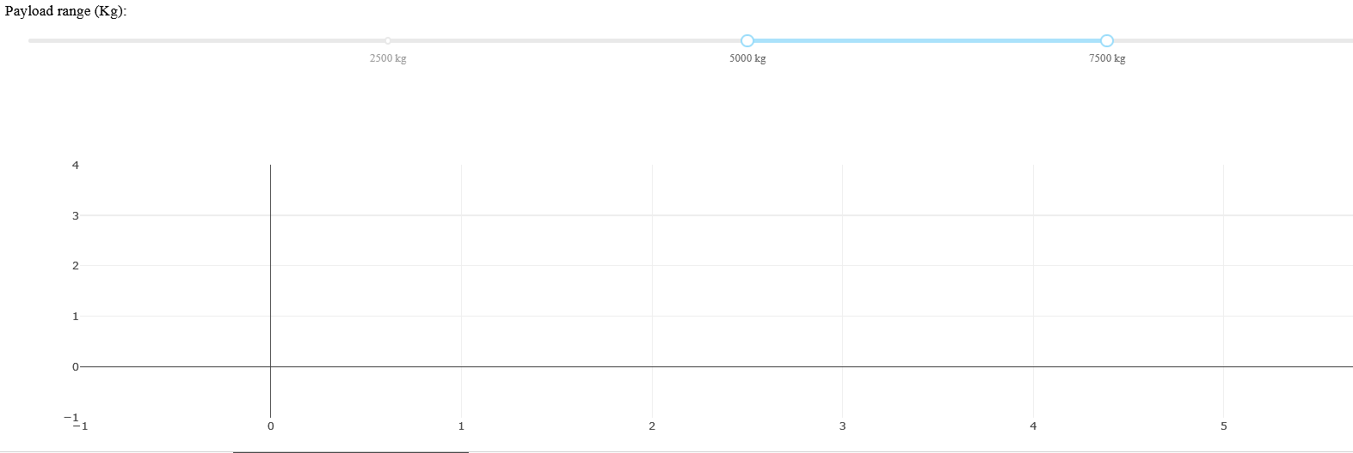
Scatterplot (Payload versus the Launch Outcomes for all of the sites)
A comparison between the different payloads using the range slider can be made. With the slider ranging from 2500 to 7500 kg, a low weighted payload 2500 to 5000kg vs a higher weighted payload of 5000 to 700kg produced a significant finding:
The lower weighted payload produced more success rates than the heavy ones.

Slide 42

Section 5

Slide 43
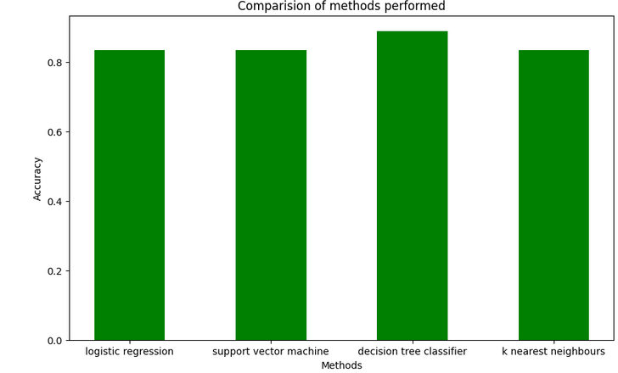
Classification Accuracy
Almost all of the models have the same accuracy, except that of the decision tree classifier, which exceeds the 83.3 percent of the other models.

Slide 44
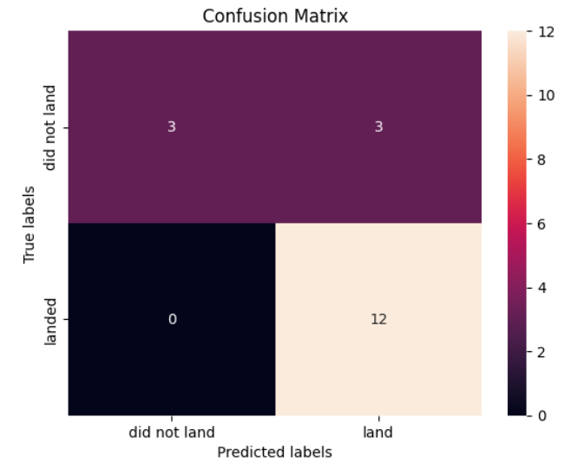
Confusion Matrix
As seen in the confusion matrix (on the right), for the decision tree classifier model.
There is an issue with false positives (true labels shows unsuccessful landings when the model indicates that 3 landings were successful)
The classifier tends to over predict.

Slide 45
Conclusions
Based on the project carried out, it can be concluded that:
Data was collected using the API from the public SpaceX API and the web scraping data from the SpaceX Wikipedia page.
The first successful ground landing date was calculated to 2010-06-04
The calculation of the total number of successful and failure mission outcomes were done: 1 failure (in flight), 99 successes and 1 single success where the payload status was unclear.
The Decision Tree Classifier is indicated to be the best choice to carrying out the Predictive Analysis stage of the project.
However, the model tends to over predict and has cases of false positives (as seen in the confusion matrix)

Slide 46


